Slide 1
How to verify barcodes by using R
By: Rebecca Herrera

Slide 2
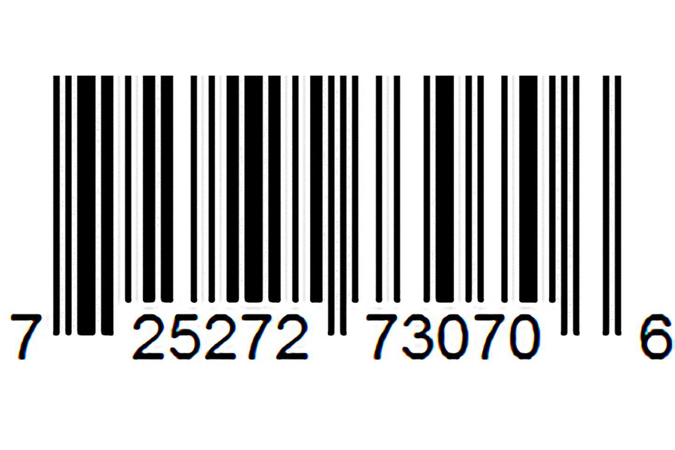
Background
Universal product codes (UPC for short) are the little barcodes you find on basically any packaged item
When we view barcodes, we interpret them as thin or thick bars and wide or narrow gaps
The bars have four different widths:
Thicker bars being 2, 3, or 4 times the width of the thinnest bar
Similarly, the gaps also have 4 different widths:
Wider gaps being 2, 3, or 4 times the width of the thinnest gap

Slide 3
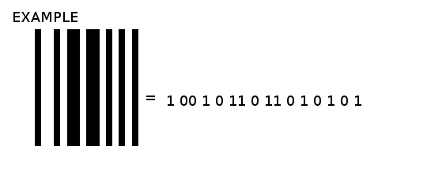
Background cont.
Although they may not look like it, UPC’s are binary codes with 95 bits
Each bar is a one while each gap is a 0
The width determines the amount of 0’s or 1’s

Slide 4
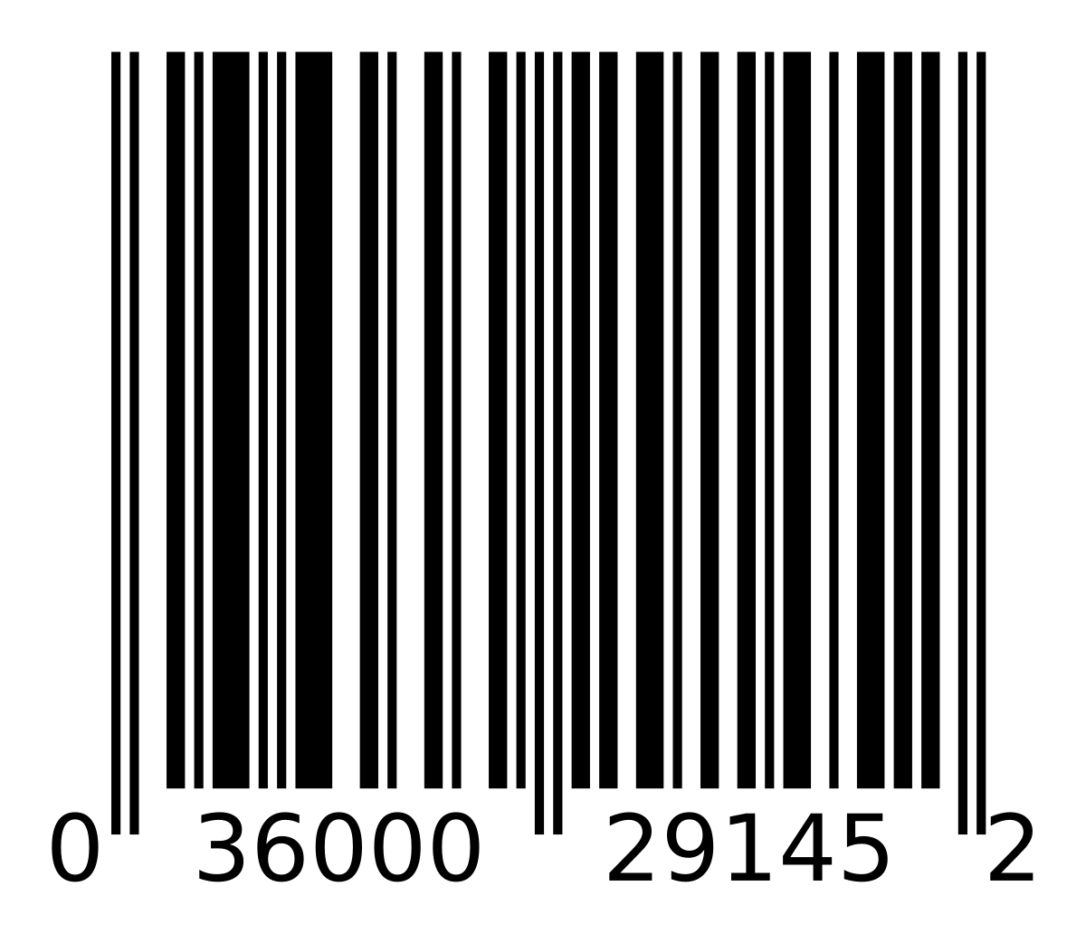
How to verify barcodes
To verify a barcode, we must verify the modulo check character
This is the last number in our barcode
Assign each digit a letter A-L
A BCDEF GHIJK L
Now we calculate the following:
(3*(A + C + E + G + I + K) + (B + D + F + H + J)
(3*(0 + 6 + 0 + 2 + 1 + 5) + (3 + 0 + 0 + 9 + 4) = 58
After calculating that we now want to subtract the number we got from the next highest multiple of 10
60 – 58 = 2
A B C D E F G H I J K L

Slide 5
Let’s try some examples
0 39402 01700 4
Valid or not valid?
0 14113 91002 6
Valid or not valid?

Slide 6
How does this tie into technology?

Slide 7
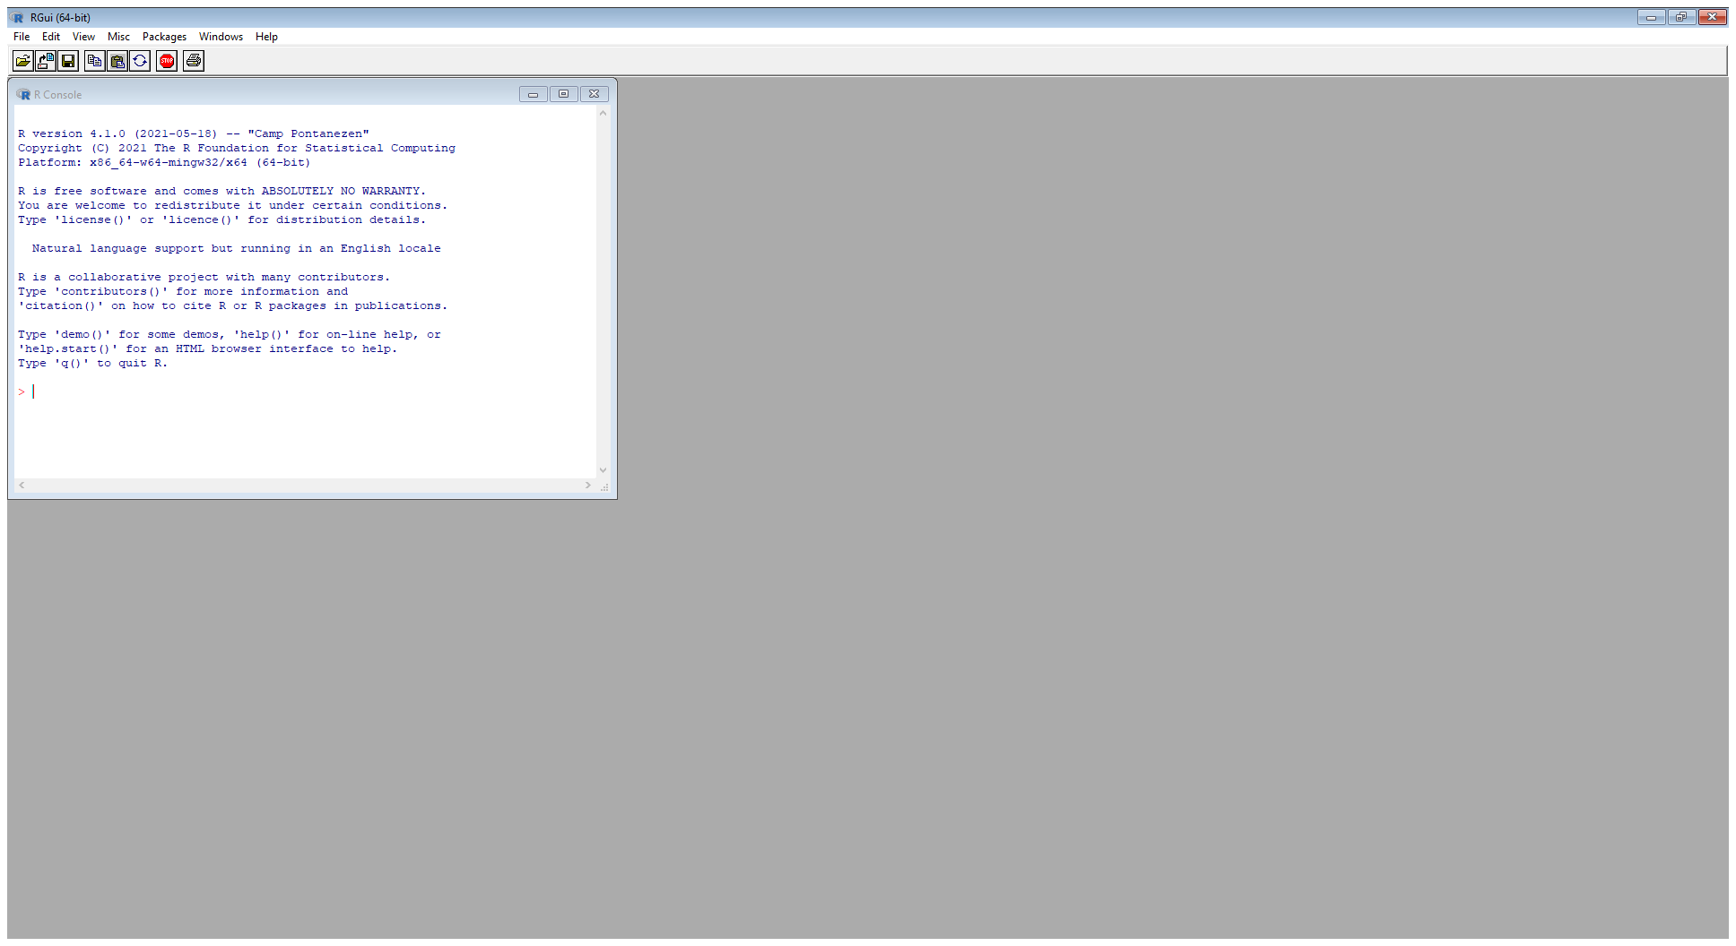
Let’s move to R

Slide 8
Basic R tutorial
R can be used a calculator, so let’s plug in 2+3 and see what happens
Instead of calculating that every time, we can store the answer in a variable
Use <- to save 2+3 in variable x
After doing this we must tell R to print it out by entering print(x)
We are also able to store list of numbers. These are called vectors
To store the vector (3, 6, 9) in variable y, we need to use the c() function
y <- c(3, 6, 9)
Sometimes we want to know the sum of the elements in our variable
Try inputting sum(y)
Let’s do a sequence
Input seq(1, 12)
Also try seq(1, 12, by=2)

Slide 9
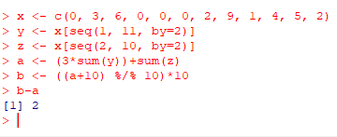
Let’s Verify barcodes in R
0 36000 29145 2
After storing the barcode, we want to start the process of solving:
(3*(A + C + E + G + I + K) + (B + D + F + H + J)
We want to subtract the number we got from the next highest multiple of 10
Notes:
Since this is a list of numbers, what should we try doing in R?

Slide 10
Let’s try some more
0 98307 10048 9
0 17600 02177 9

Slide 11
Now you know how to solve barcodes on paper and in R!

Slide 12
Citations
Petzoid, Charles. Code: The Hidden Language of Computer Hardware and Software. Microsoft Press, 2000.

